Slide 1



H GH VOLTAGE

Slide 2
5
4
3
2
1
START

Slide 3


Slide 4




Slide 5

House Of Starks

Slide 6





Slide 7






Extreme Exploders

Slide 8




Slide 9

Clueless

Slide 10




Slide 11

Corporate Criminals
Corporate Criminals

Slide 12




Slide 13

F
SQUARE

Slide 14




Slide 15
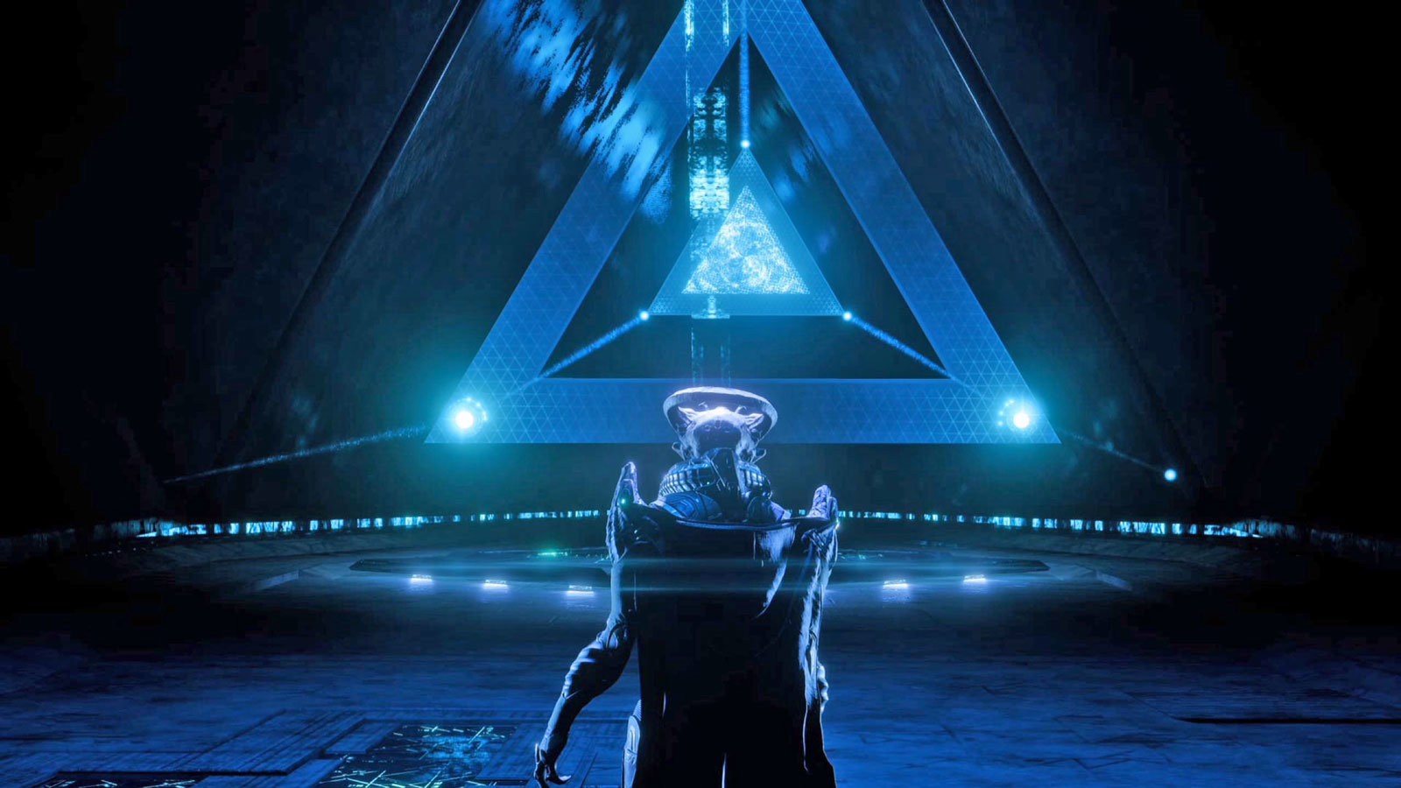
ANDROMEDA

Slide 16




Slide 17

Liquid

Slide 18




Slide 19


Slide 20




